Slide 1
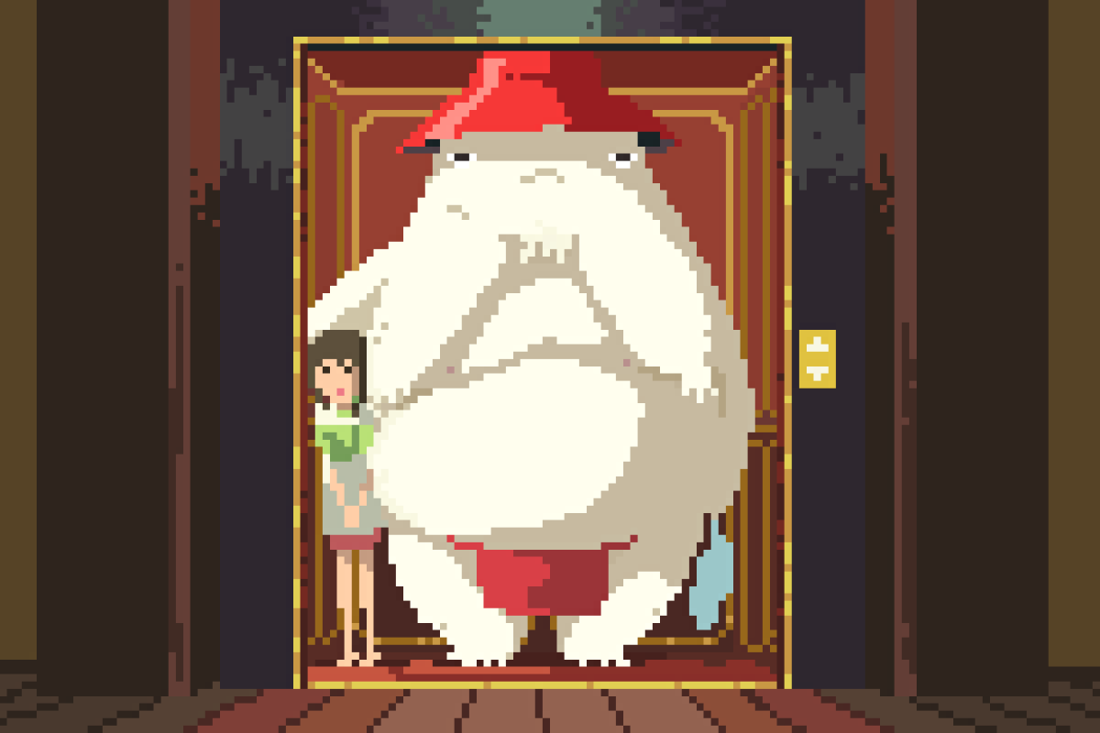

Slide 2
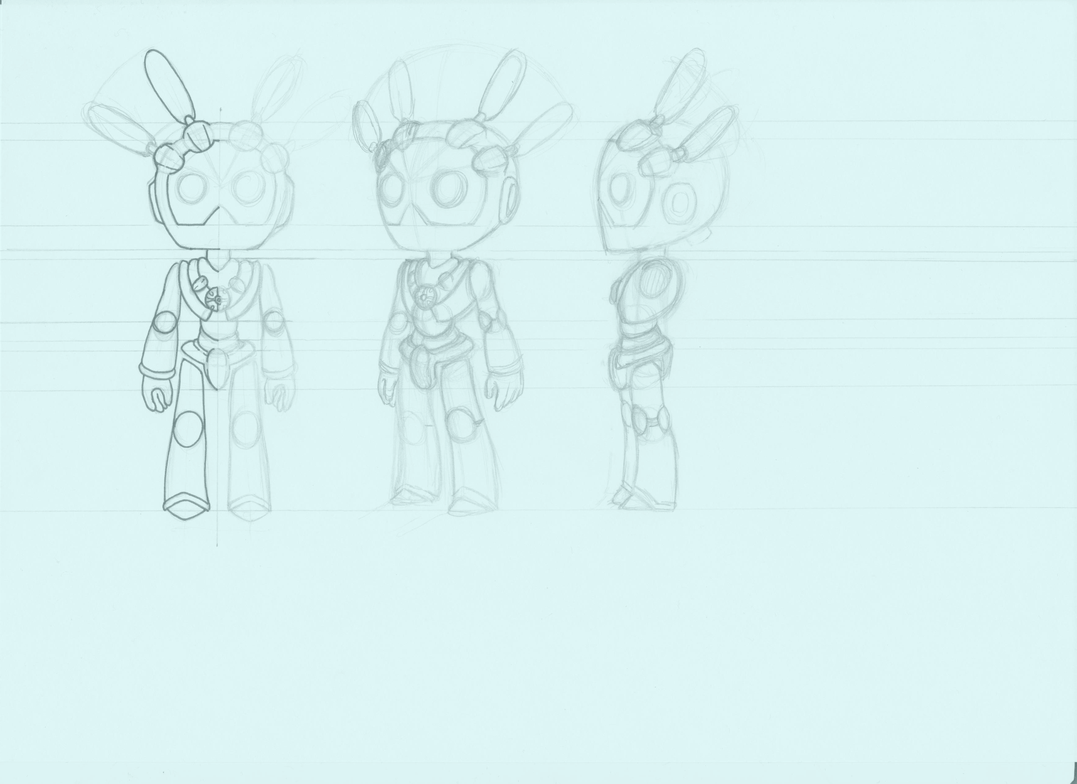
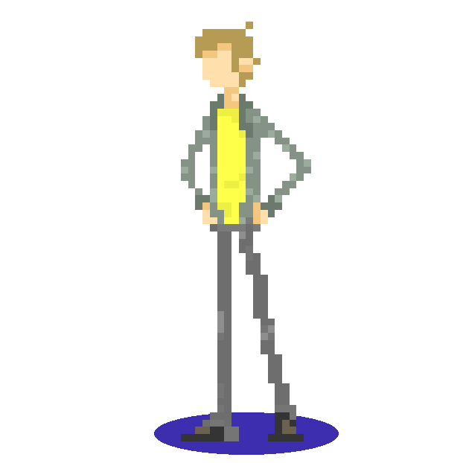
Niklas „Manager“ Burrichter
Manager
Level design
Implementation of art assets
Power up design & programming
Audio design & programming
Notes:
Hello, welcome to our presentation. We are: Niklas Burrichter – our Manager

Slide 3
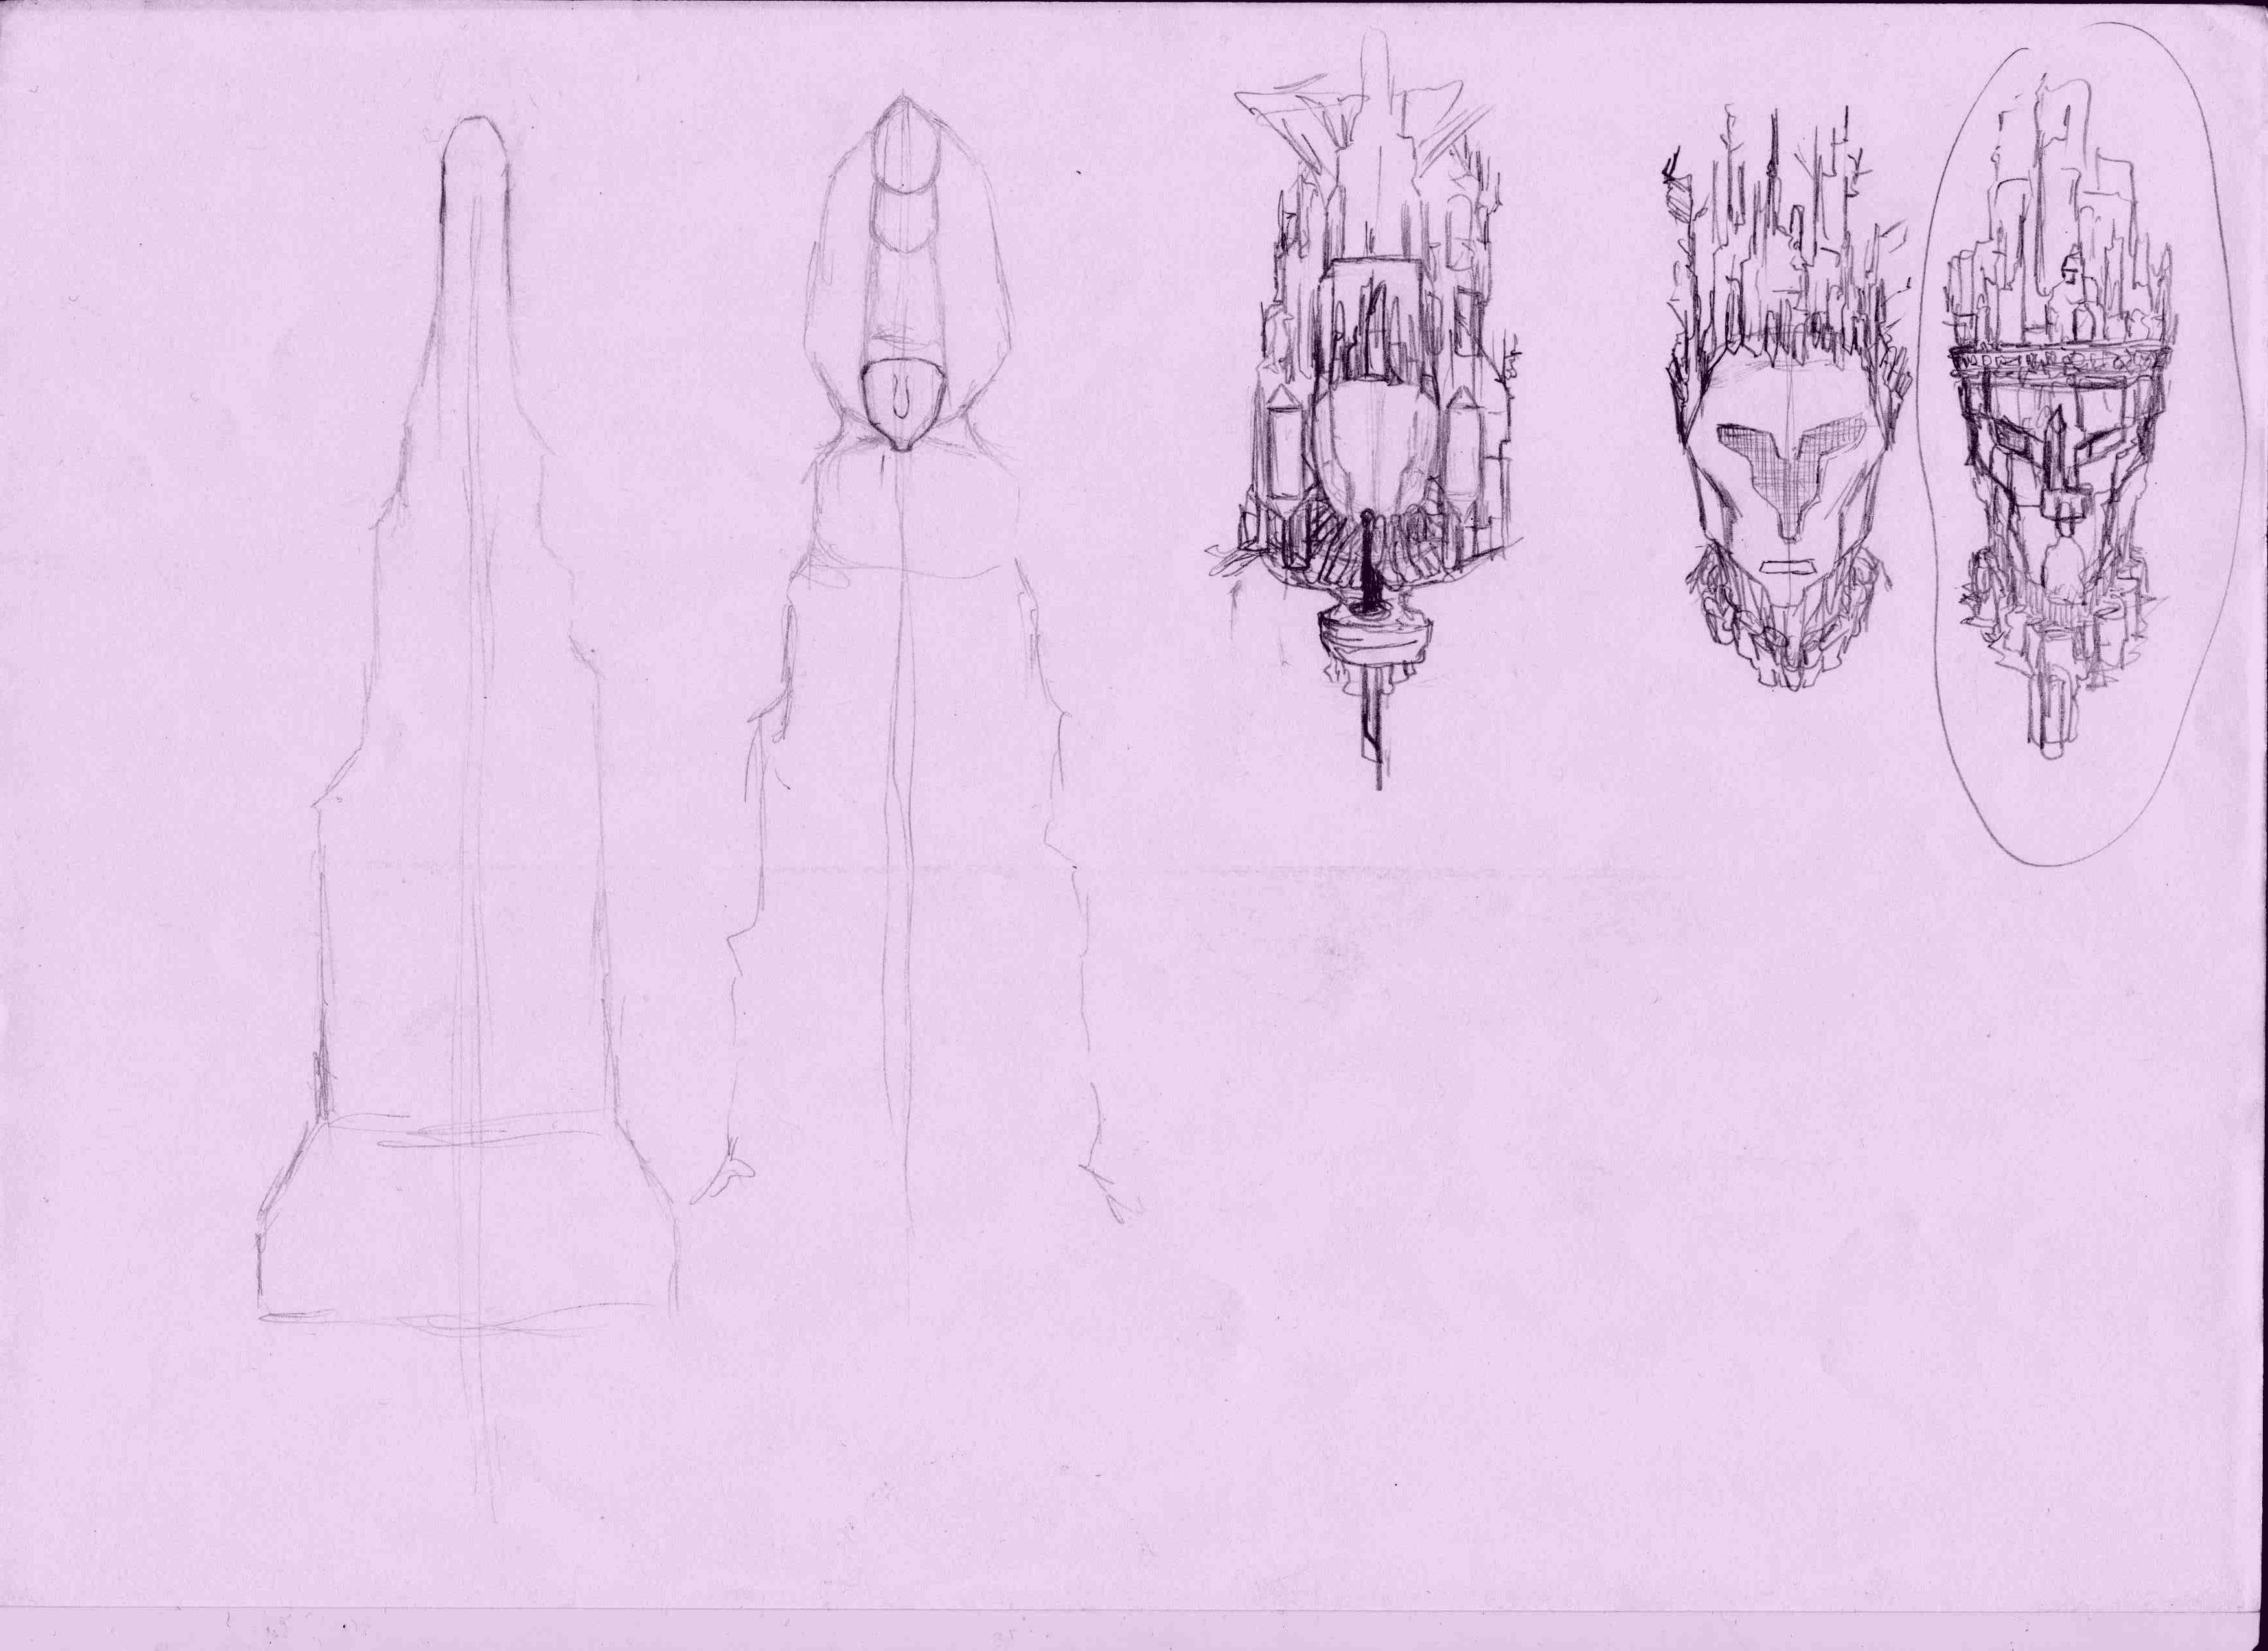
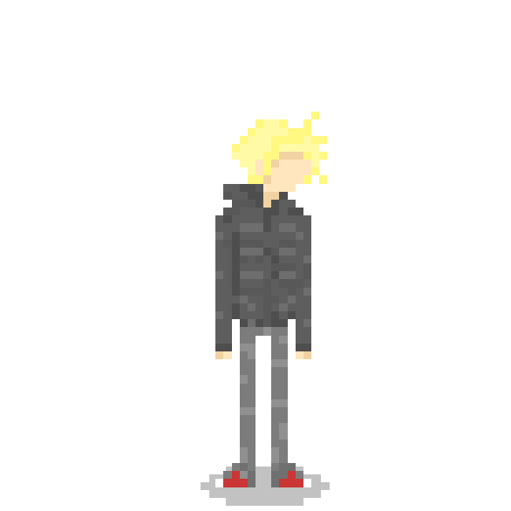
Emilia „Elliot“ Nilges
Tileset design
Character & enemy design
Visual effects design & programming
Notes:
Emilia Nilges – our Lead Artist

Slide 4
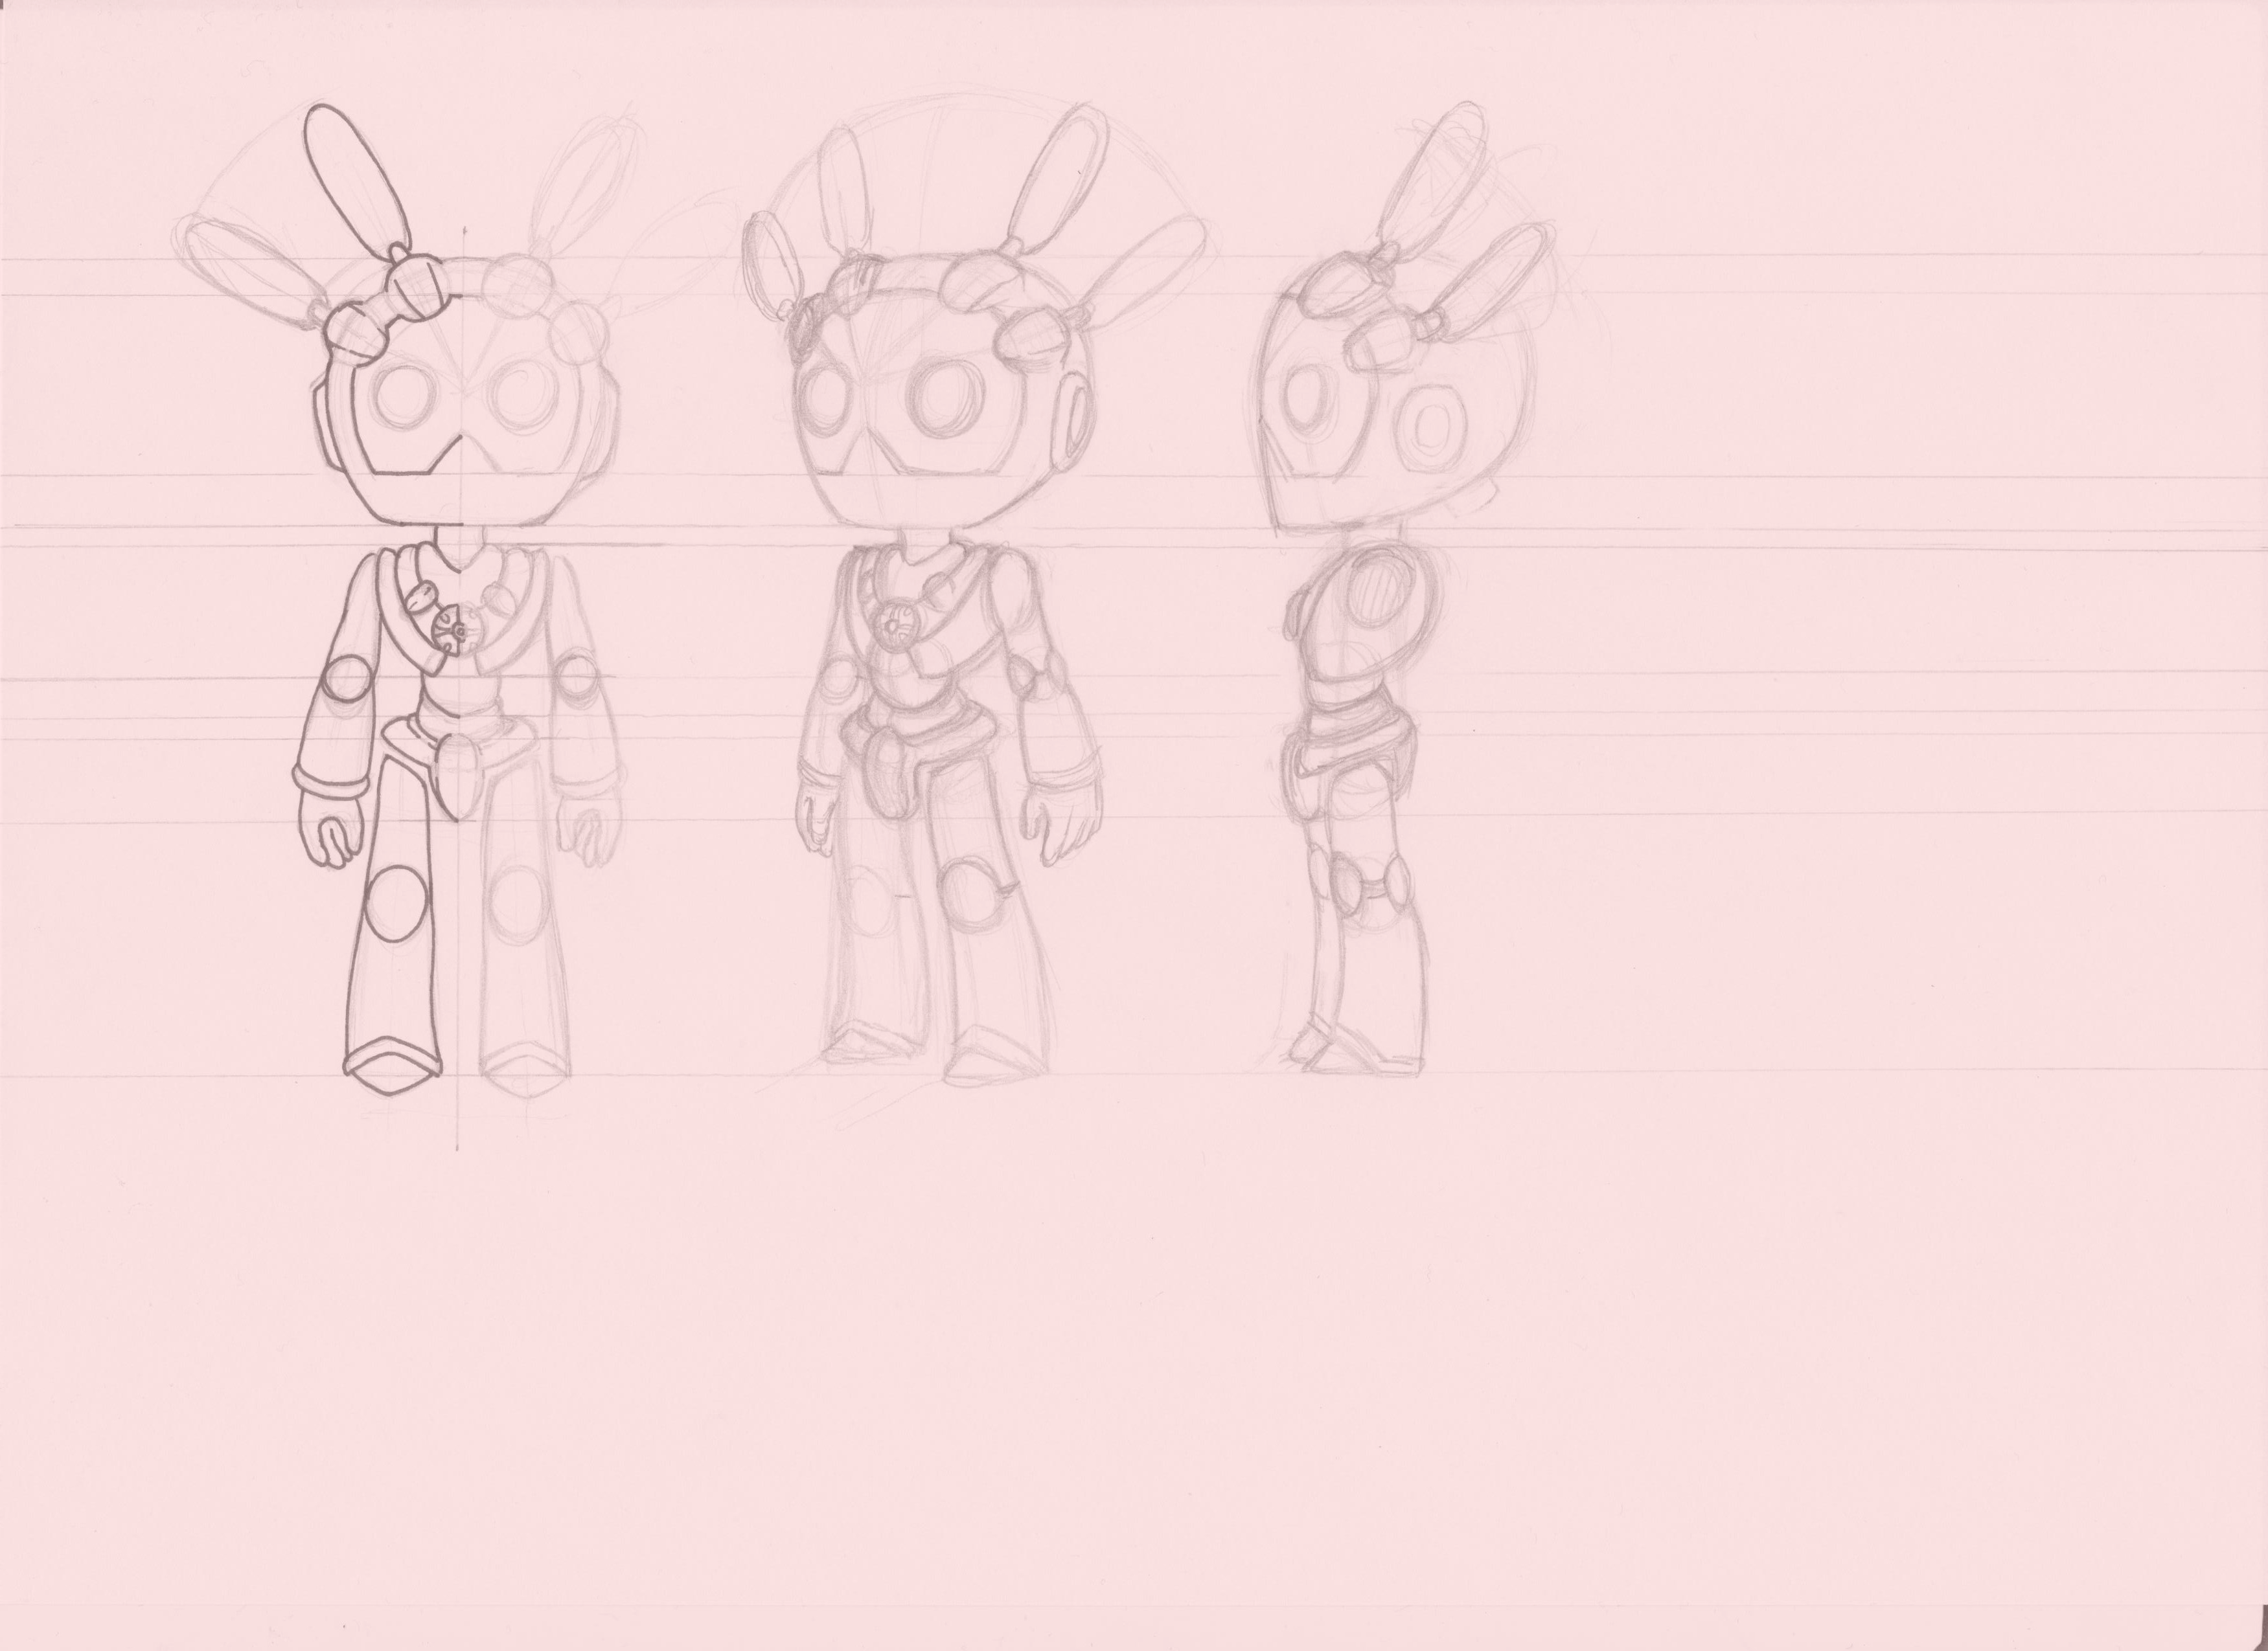

Niklas Weber
Vision keeper
Narrative design
Character design
Background design
Audio design
Notes:
Niklas Weber – our Vision Keeper

Slide 5
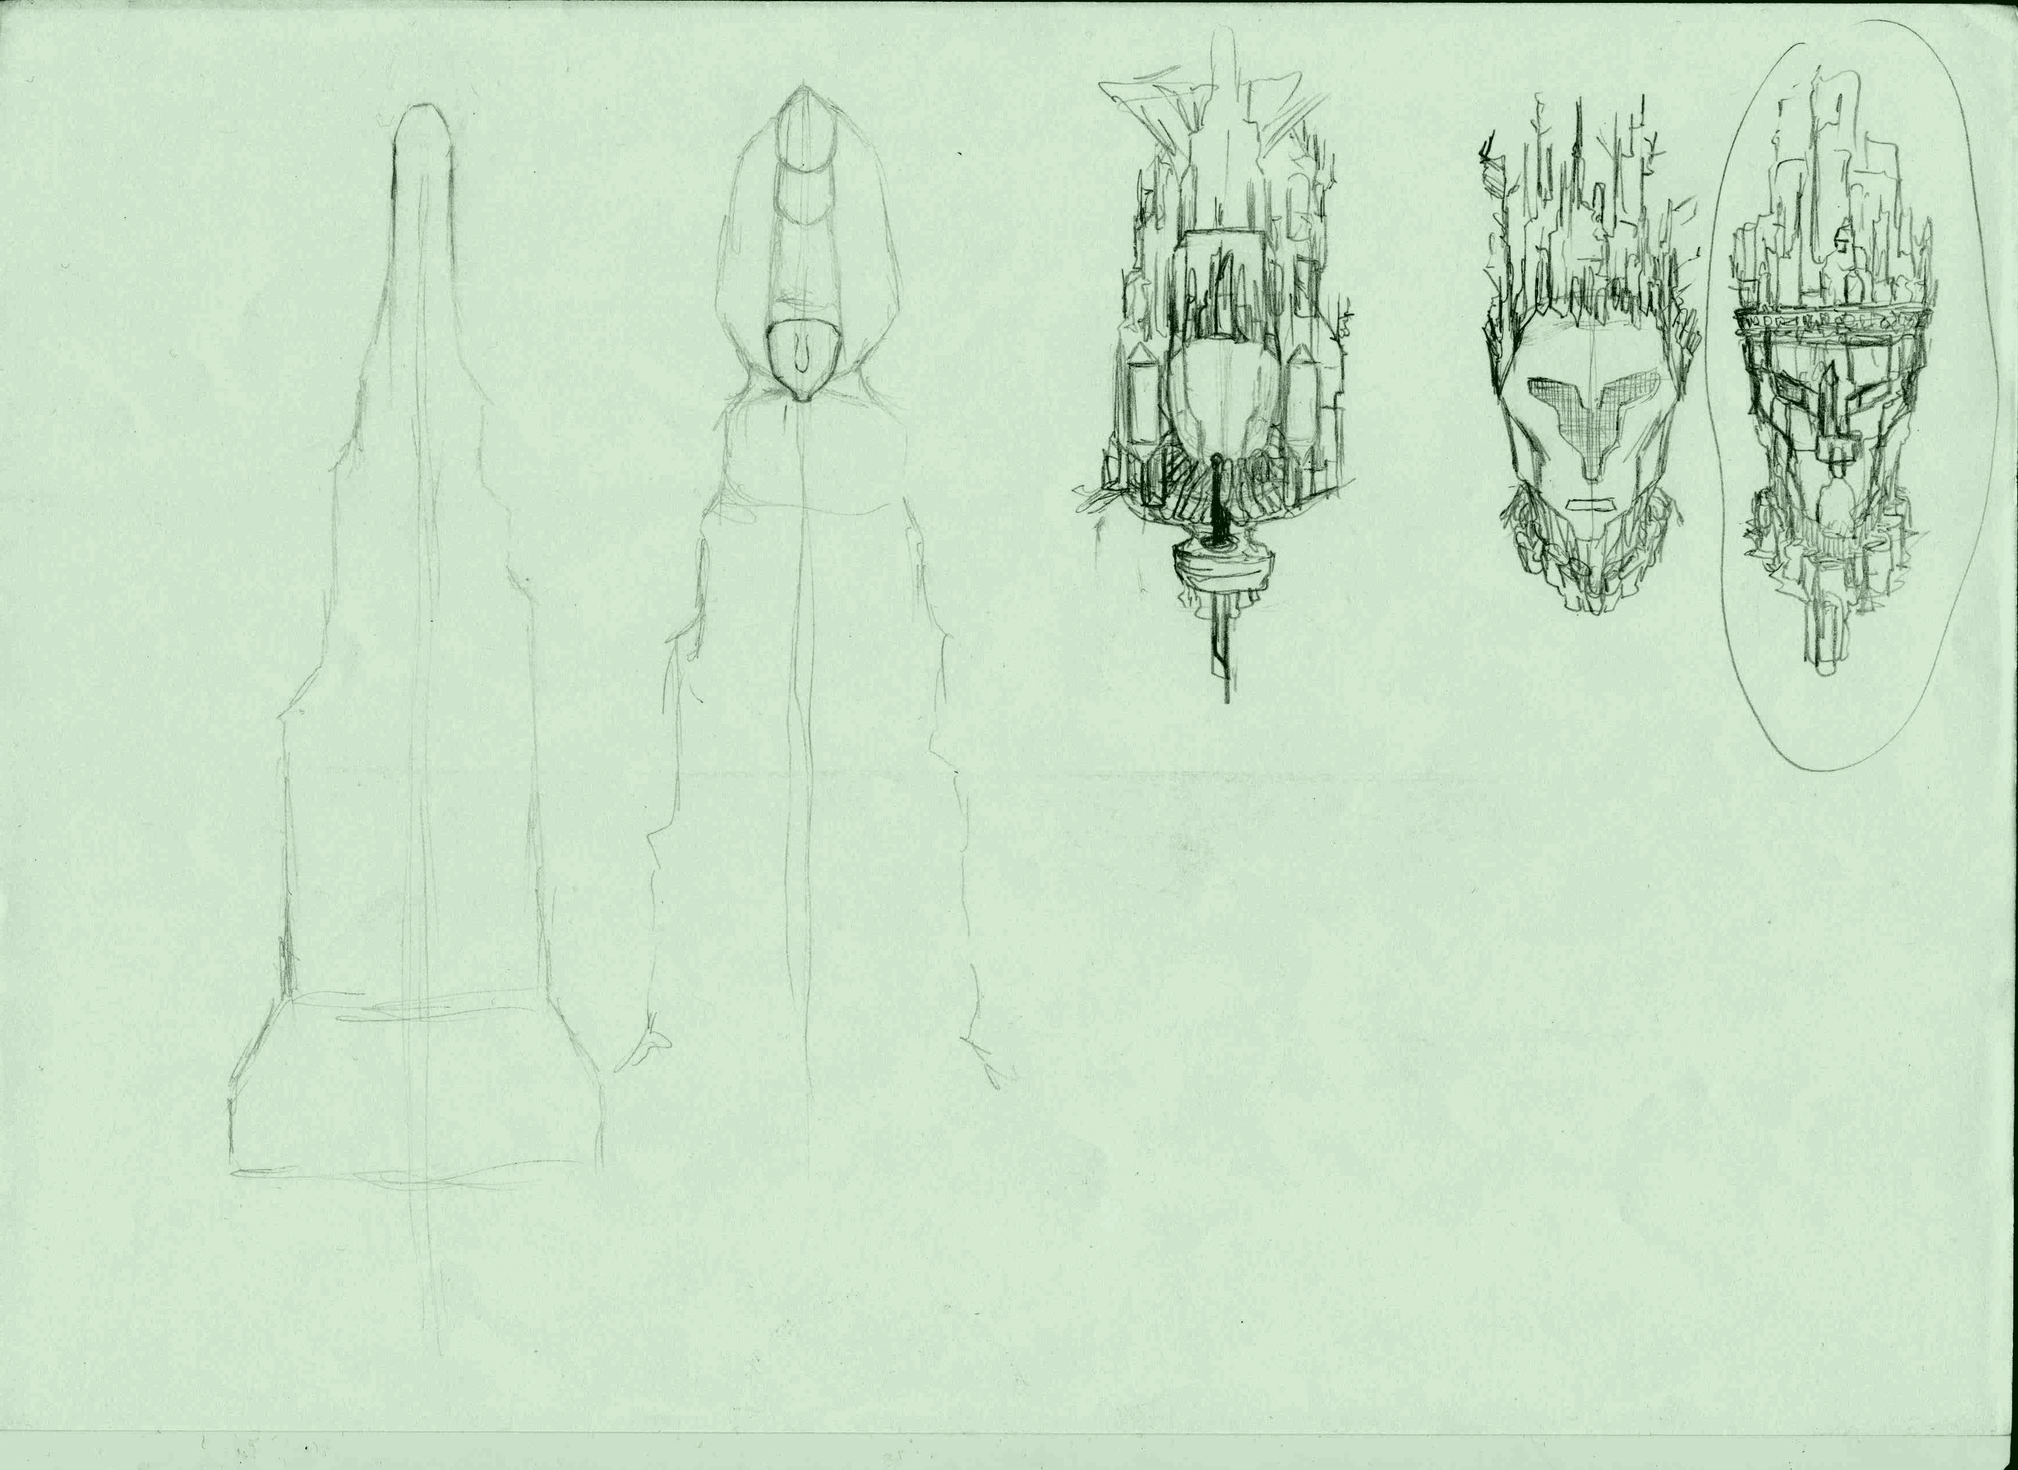

Daniel Bosselmann
Character & enemy programming
Menu programming
Visual effects design & programming
Level design
Notes:
And Daniel Bosselmann – our Lead Programmer.

Slide 6
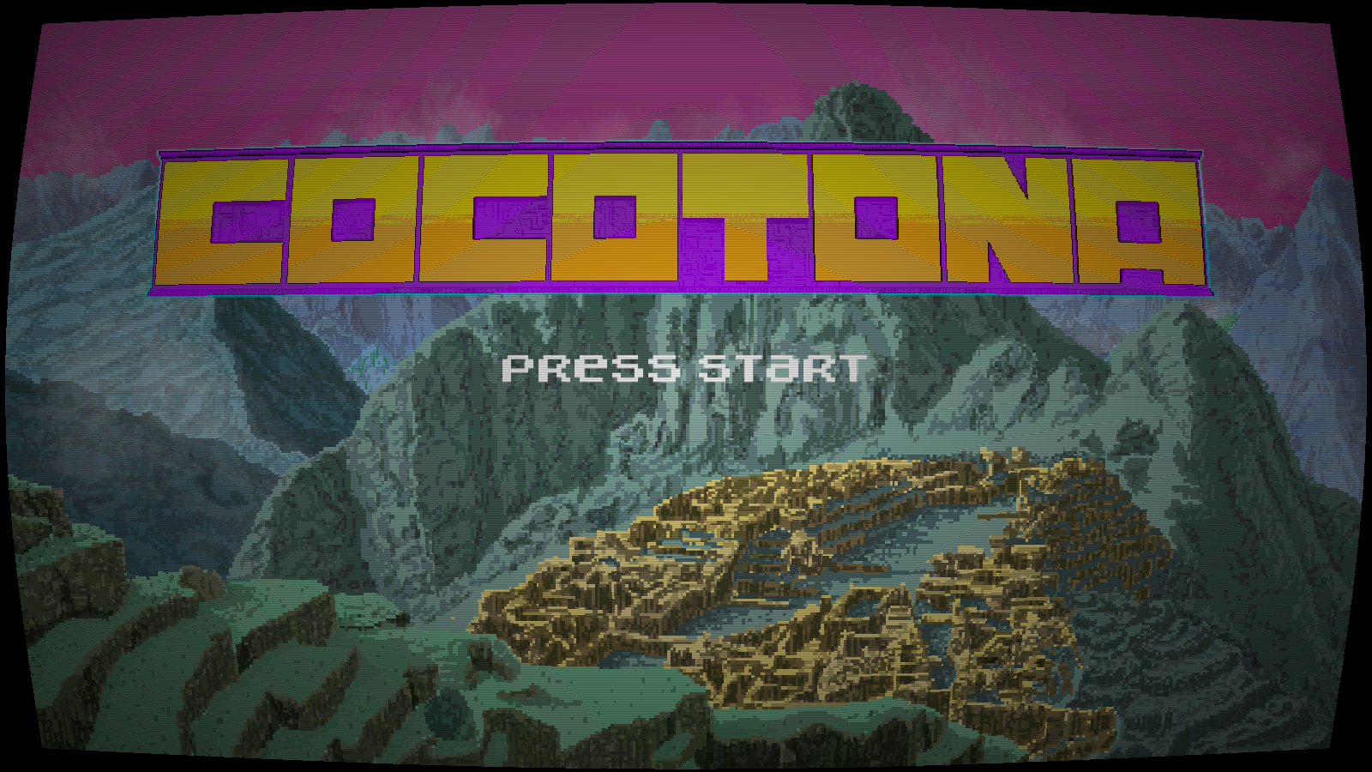
Notes:
And we made this game. Cocotona is a Co-op Jump ‘n‘ Run targeted at players of the age 12plus for the pc with a unique control sheme in which...

Slide 7
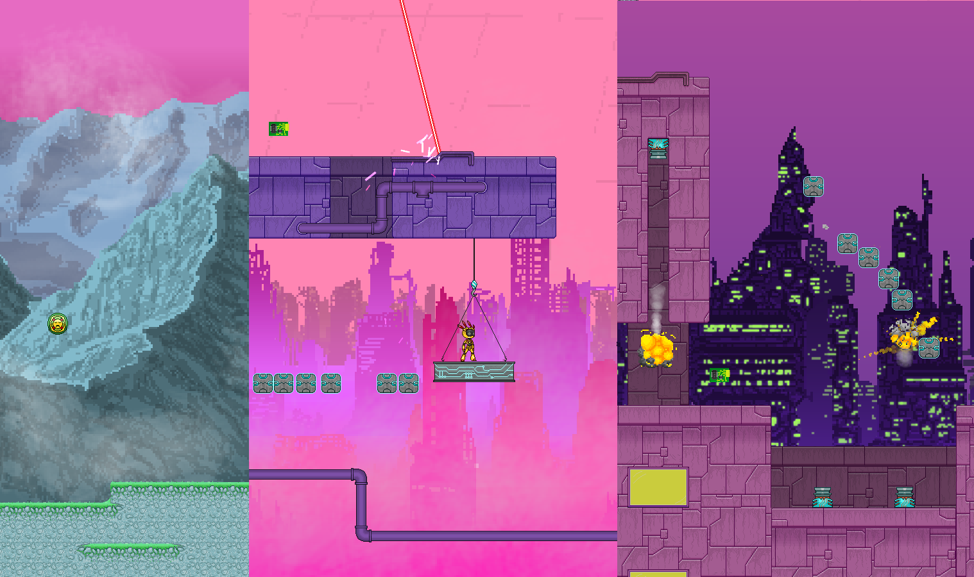
Notes:
… you travel as a robot or his companion drone through old mountain ruins and futuristic cyberpunk cities to reach your goal and find your one true destiny.

Slide 8
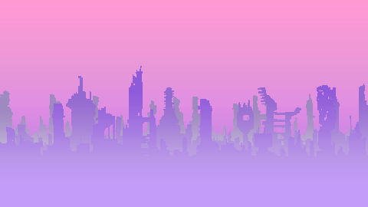
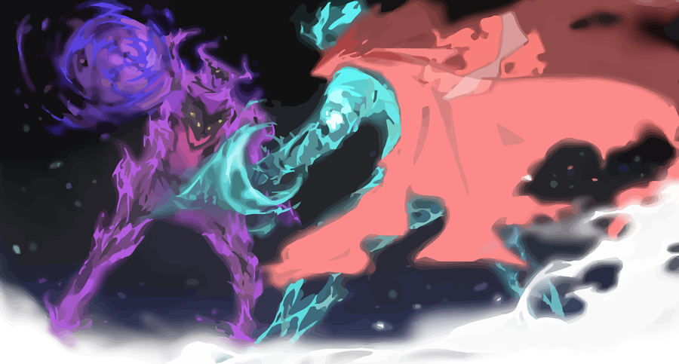
Notes:
In an alternate cyberpunk future set in the Aztec mythology once again the powers of the world have shifted: The cybergods, creators of civilization, broke apart in conflicts and caused the structures of the world to collapse.

Slide 9
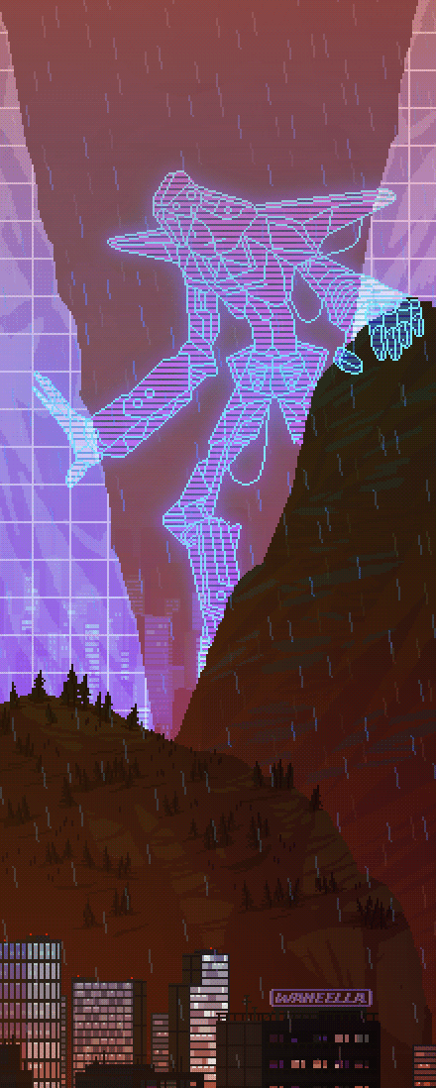
Notes:
One, just one remainder of their kind separated and holed himself up under his almost impenetrable dome to start a new creation of his very own…
The war of the gods ended. But not everything outside was dead.

Slide 10
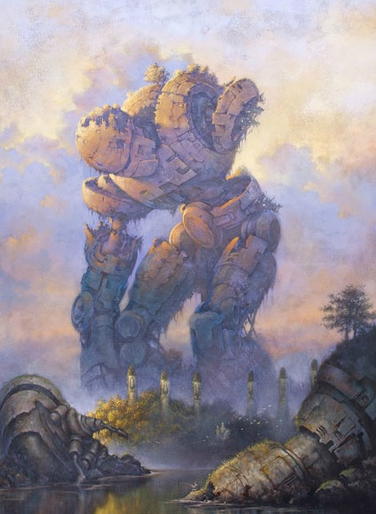
Notes:
Beyond the dome some ingenious human beings survived and band together to seize their opportunity to break the cycle of destruction. From the remainders found on the battlefield they created a god of their own to send against their enemies.

Slide 11
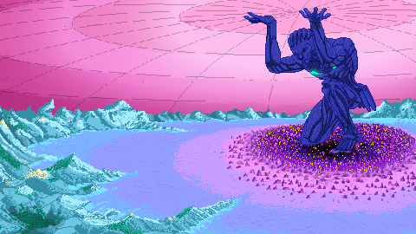
Notes:
With all their might they fought their way to the dome and victory was near.

Slide 12
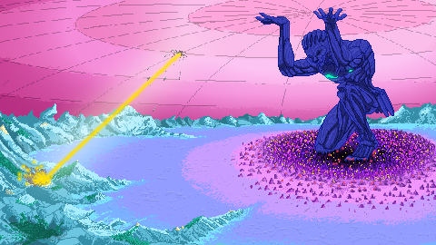
Notes:
Yet in the last moment, as their creation, the mecha god came to break through the dome’s outer shell, the power he unveiled was so enormous, that he broke apart.
The remainders of his body, unseen through the heat of battle, still got inside and out of them the last hope to bring an end to the cycle of destruction.

Slide 13
DEMO

Slide 14
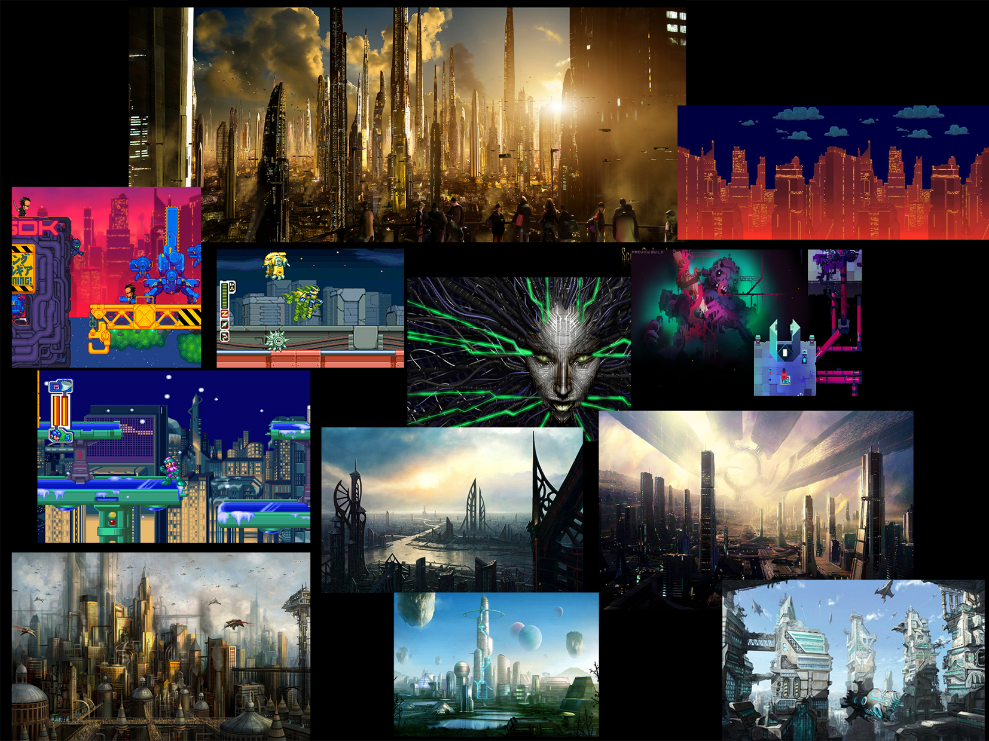
Notes:
Visual Development

Slide 15

Core Gameplay Loop
Notes:
The core gameplay loop is quite simple: Player A needs to progress in a direction he can‘t reach without help.

Slide 16

Core Gameplay Loop
Notes:
Player A jumps in that direction.

Slide 17

Core Gameplay Loop
Notes:
Player B „catches“ him by placing a block underneath him.

Slide 18

Core Gameplay Loop
Notes:
As soon as he lands the block underneath him starts to disappear...

Slide 19

Core Gameplay Loop
Notes:
... which forces Player A to jump again.

Slide 20

Core Gameplay Loop
Notes:
And to repeat the whole process anew.

Slide 21
4 – 2 – 1

Slide 22
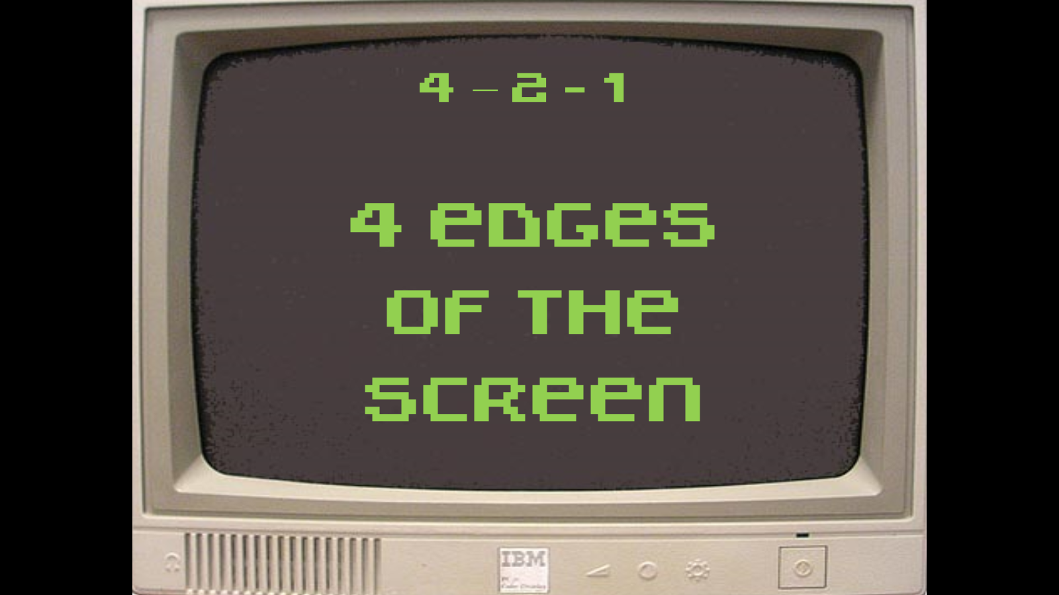

Slide 23
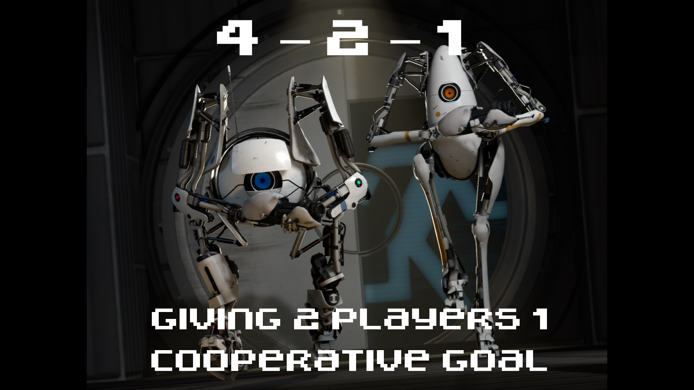

Slide 24
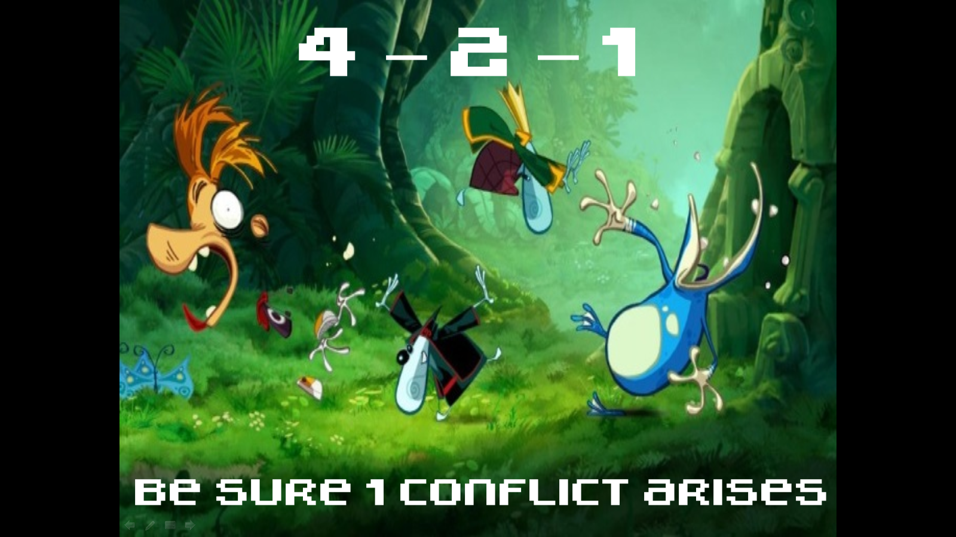

Slide 25




Technologies we used:
Notes:
To achieve this goal we used Game Maker: Studio as a game engine. SourceTree for source control and in the art department we used Photoshop and Paint tool sai.

Slide 26
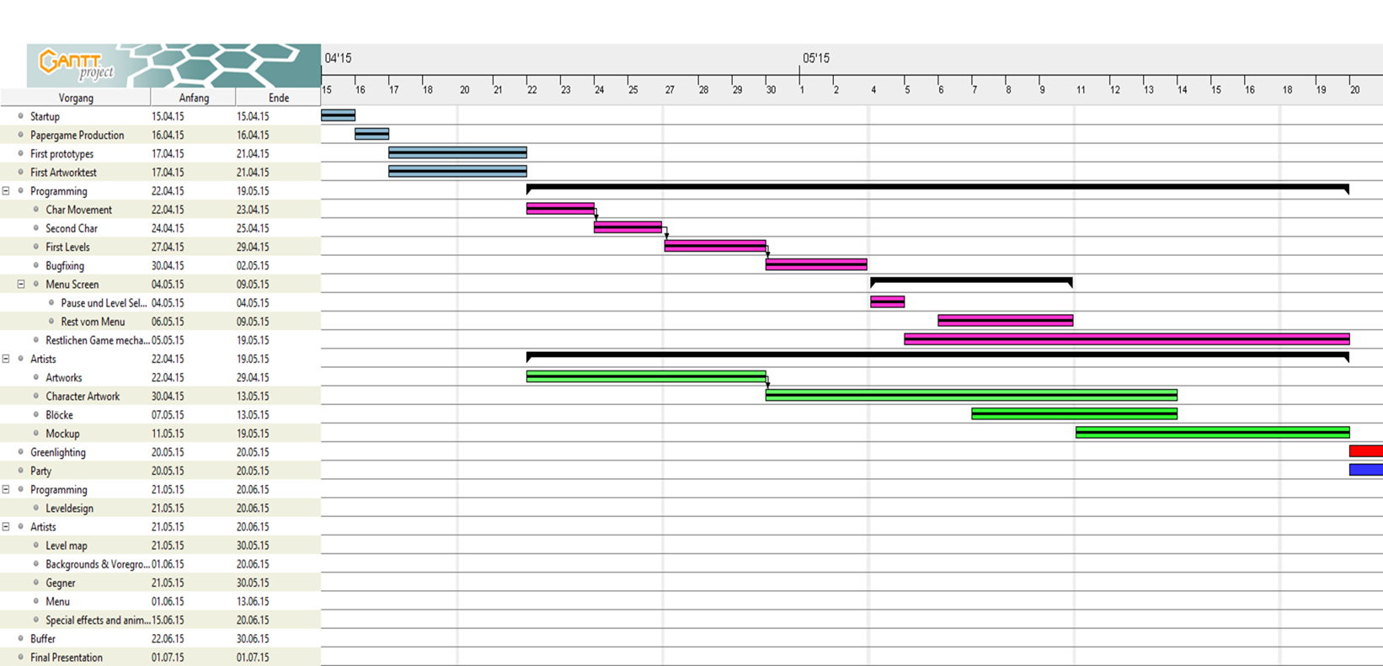
Production Schedule pt. 1

Slide 27
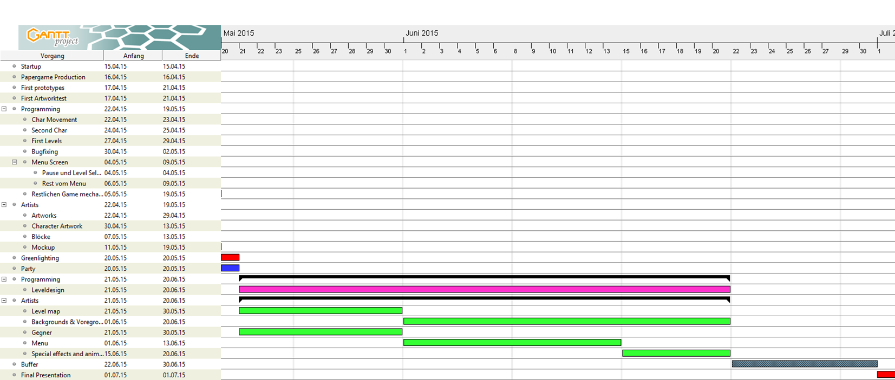
Production Schedule pt. 2

Slide 28
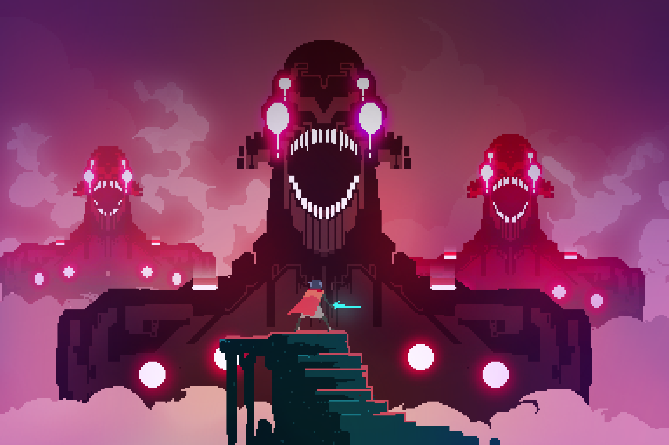
How to extend the game:
Notes:
Bossbattles

Slide 29
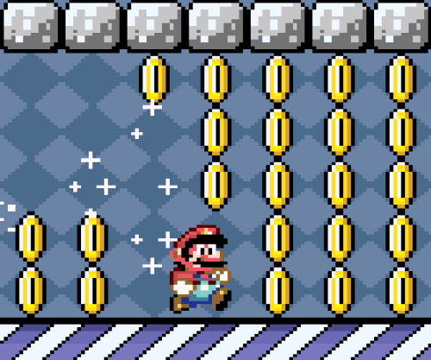
How to extend the game:
Notes:
Add collectibles because they make everything better.

Slide 30
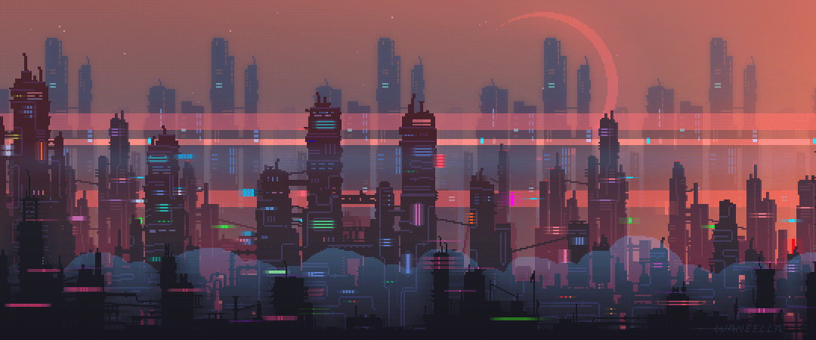
How to extend the game:
Notes:
An animated Intro would be great.

Slide 31
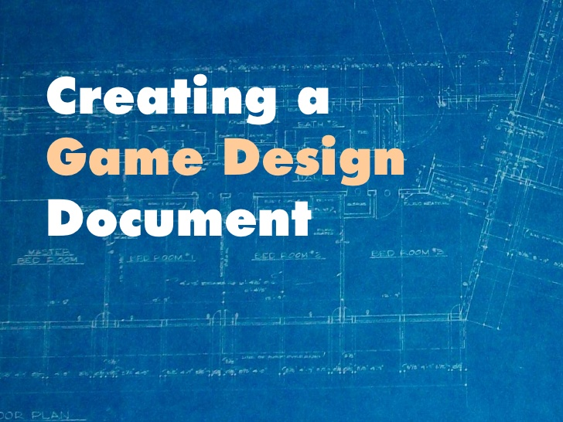
Lessons learned:
Notes:
Design Document

Slide 32
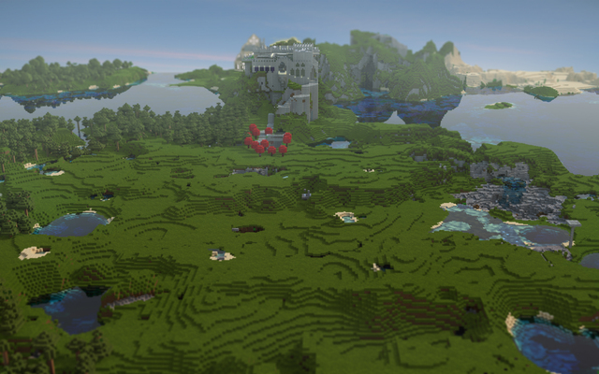
Lessons learned:
Keeping it small
Notes:
Keeping it small.

Slide 33

Lessons learned:
There‘s always better Organization
Notes:
Better organization

Slide 34
Thank You
Notes:
An animated Intro would be great.

